Slide 1
TEAM ID | PNT2022TMID25992
PROJECT NAME | SMART SOLUTIONS FOR RAILWAYS
PROJECT DEVELOPMENT DELIVERY OF SPRINT-3
Efficient and Secure Operation with Better Passenger Experience:
Trams and trains are an indispensable part of urban transportation. With continuous waves of urbanization, it is required that operation of the rail transit system be more intelligent and efficient. As those vehicles run in separate and closed tracks, railways entail a number of challenges and risks in terms of security and management, including engines, doors, fire control, as well as vibration and electromagnetic disturbance. Making sure everything is in good order can be a major challenge. Danger must be identified as soon as possible, as accidents mean not only revenue losses, but more importantly, life security.
Meanwhile, with a large amount of time spent on the way, travel is expected to be not only convenient but also pleasant – especially in the IOT era where everything can and should be
connected. Better passenger experience is the key to success in the increasingly fierce market competition.
Thus, a full-functional communications system is needed for rail transportation.

Slide 2
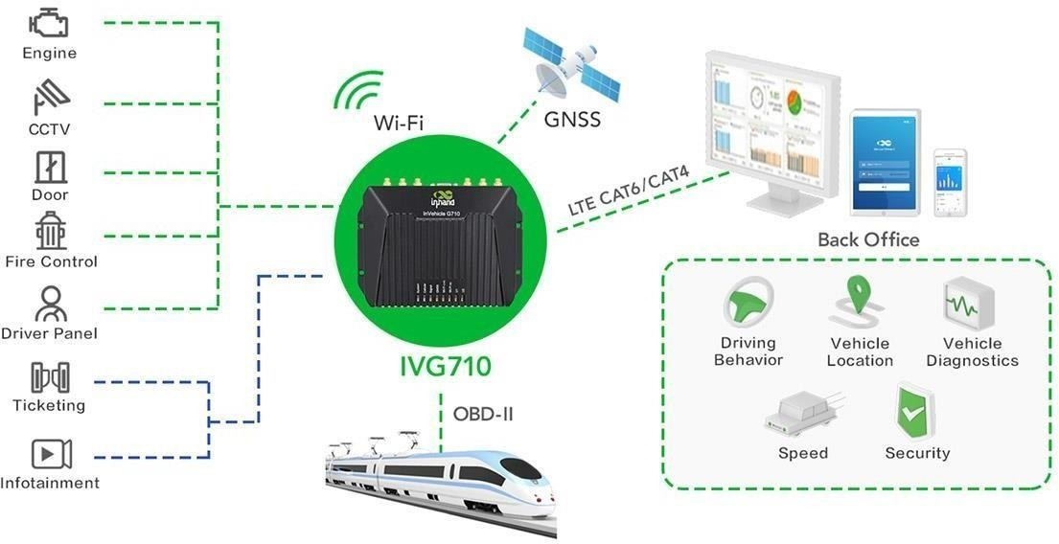
In Hand’s Connectivity Solution for Rail Transit:

